Slide 1
OOP

Slide 2
What is Object-oriented Programming
Object-Oriented Programming is a strategy that provides some principles for developing applications or developing software. It is a methodology. Like OOPs, other methodologies are also existing such as Structured Programming, Procedural Programming, or Modular Programming. But nowadays, one of the well-known and famous styles is Object Orientation i.e. Object-Oriented Programming.
Modular programming
Modular programming is a programming paradigm that focuses on dividing a program into separate modules or independent units of functionality. Each module is responsible for a specific task and can be developed and tested independently. These modules can be organized hierarchically, with higher-level modules using lower-level modules to accomplish more complex tasks. Modules communicate with each other through well-defined interfaces.
Object-Oriented Programming (OOP):
Object-oriented programming is a programming paradigm that focuses on designing software around objects, which are instances of classes. A class is a blueprint that defines the attributes (data) and behaviors (methods) of an object. Objects can interact with each other by invoking methods and accessing each other's data.

Slide 3
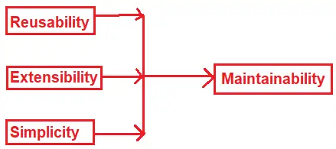
What are the Problems of Modular Programming?
Reusability: In Modular Programming, we need to write the same code or logic at multiple places which increases the code duplication. Later if we want to change the logic, then we need to change it at all places.
Extensibility: It is not possible in modular programming to extend the features of a function. Suppose you have a function and you want to extend it with some additional features then it is not possible. You have to create a completely new function and then change the function as per your requirement.
Simplicity: As extensibility and reusability are not possible in Modular Programming, usually we end up with lots of functions and lots of scattered code.
Maintainability: As we don’t have Reusability, Extensibility, and Simplicity in modular Programming, it is very difficult to manage and maintain the application code.

Slide 4
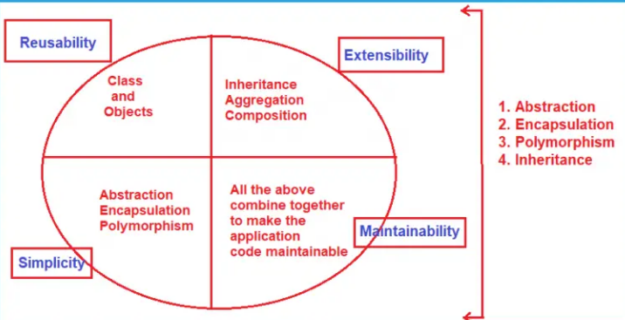
How we can overcome Modular Programming Problems?
Reusability:
To address reusability, object-oriented programming provides something called Classes and Objects. So, rather than copy-pasting the same code again and again in different places what you can do here is, create a class and make an instance of the class which is called an object, and reuses them whenever you want.
Extensibility:
Suppose you have a function and you want to extend it with some new features that were not possible with functional programming. You have to create a completely new function and then change the whole function whatever you want. In OOPs, this problem is addressed by using some concepts called Inheritance, Aggregation, and Composition. In our upcoming article, we will discuss all these concepts in detail.
Simplicity:
Because we don’t have extensibility and reusability in modular programming, we end up with lots of functions and lots of scattered code and from anywhere we can access the functions, security is less. In OOPs, this problem is addressed by using some concepts called Abstraction, Encapsulation, and Polymorphism.
Maintainability:
As OOPs address Reusability, Extensibility, and Simplicity, we have good maintainable code and clean code which increases the maintainability of the application.

Slide 5
What are the OOPs Principles or OOPs Concepts in C#?
OOPs, provide 4 principles. They are:
Encapsulation
Inheritance
Polymorphism
Abstraction

Slide 6
The process of representing the essential features without including the background details is called Abstraction. In simple words, we can say that it is a process of defining a class by providing necessary details to the external world which are required by hiding or removing unnecessary things.
The process of binding the data and functions together into a single unit (i.e. class) is called Encapsulation. In simple words, we can say that it is a process of defining a class by hiding its internal data members from outside the class and accessing those internal data members only through publicly exposed methods or properties. Data encapsulation is also called data hiding because by using this principle we can hide the internal data from outside the class.
We can achieve code Simplicity through Encapsulation and Abstraction.
The process by which the members of one class are transferred to another class is called inheritance. The class from which the members are transferred is called the Parent/Base/Superclass and the class which inherits the members of the Parent/Base/Superclass is called the Derived/Child/Subclass. We can achieve code extensibility through inheritance.
The word Polymorphism is derived from the Greek word, where Poly means many and morph means faces/ behaviors. So, the word polymorphism means the ability to take more than one form. Technically, we can say that when the same function/operator will show different behaviors by taking different types of values or with a different number of values called Polymorphism.

Slide 7
Classes
A class is a Blueprint of objects. A class encapsulates data (stored in fields) and behaviour (defined by methods) .It is used to describe the state and behaviour that an object will have
Anatomy of a Class:
Field – Describes the characteristics
Methods –Describes the behaviours

Slide 8
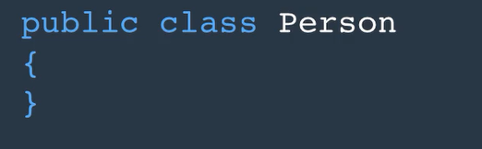
Declaring a class
To declare a class we use :
An access modifier
Class keyword
The class Name
Do declare a Field you need:
An access modifier
Data type
The Field Name
To Declare a Method you need
An access modifier
Return type
The Method Name

Slide 9
Constructors
A method that is called when an instance of a class is created.Its essence is to put an object in an early state.
It has the same name as the class
Has no return type
Every class has a contructor , whether defined or not the constructor is used to initialize field with the default values.
Constructor Overloading- This is having different constructors in the same class

Slide 10
Class Members
In classes there are two types of members:
Instance members – these are field or method that are accessible from the object
Static members – these are fields oor methods that are accessible from the class.

Slide 11
Object
An object is an instance of a class. We can create an object using the new operator
Object initializer Syntax
This is a syntax that is used to quickly initialize an object

Slide 12
Field
A field can be initialized in two ways: In a constructor, or directly upon declaration. The benefit of initializing a field during declaration is that if your class has one or more constructors, you’ll make sure that the field will always be initialized irrespective of which constructor is going to be called.
We use the readonly modifier to improve the robustness of our code. When a field is declared with readonly, it needs to be initialized either during declaration or in a constructor. The value cannot be changed. This prevents you from accidentally overwriting the value of a field, which can result in an unexpected state

Slide 13
Methods Overloading
Method overloading are methods with the same name but different method signatures.
A method signature is :
The method Name
The number and type of parameters

Slide 14
Access Modifiers
Public –Accessible from everywhere
Private –accessible only in the class
Protected accessible in the class and derived classes
Internal – available only in the assembly

Slide 15
Properties

Slide 16
Inheritance (is-a)
Inheritance is a principle in OOP that allows consuming the members defined in one class in another.
The advantage of inheritance are :
Its easy to use
It allows code Reuse

Slide 17
Composition (Has-a)
This is a relationship between two classes that help one to contain the other .
Advantages of composition over inheritance
Code reusability
Flexibility
Loose-coupling

